Slide 1
AppLink BaaS平台
让移动开发更简单
致力于构建互联网创业生态圈 帮助创业者成功
Notes:
NNG award
+ MRC Certification on first slide

Slide 2
目录
什么是BaaS
AppLink
SWOT
市场分析
竞争性分析
现状
展望未来
联系方式
Notes:
Eyeblaster Analytics is not a product – it is what marketers call a Component Brand ‘- i.e. it is a self-branded subset of a product

Slide 3

BaaS Introduce
云计算的衍生
技术分工的产物
天下武功为快不破

Slide 4






BaaS 的餐厅比喻
餐厅老板
=甲方
场地
=IssS（设施及服务）
餐厅
=PaaS（平台及服务）
决定餐厅菜色，服务，风格
决定应用功能，业务，类型
房地产商、商场
机房中心或阿里云
租赁场地
操作系统、虚拟服务器
餐厅前场
=SaaS（软件及服务）
=APP或网站
工作团队
=服务团队
厨房
=数据服务
选择菜品，服务的地方
应用提供服务，功能的界面
下单给厨房，端菜上桌子
数据管理，客户服务
订单变成菜品
用户数据加工
Notes:
Complimentary tools for different use cases
Campaign Monitor
One-click reporting (POWERPOINT GENERATOR)
Report Generator (ONLINE REPORTING)
Custom Report Builder- custom reports or service
Advanced Analytics (Plug-in for Excel)

Slide 5
BaaS 的餐厅比喻
装修
=应用开发
装修餐厅前场和后厨
开发APP的前端和后端
装修过程
=开发过程
木工、水工、电工、漆工干活
开发，设计，架构研发
厨房器件供应商
=BaaS（后端及服务）
水槽、炉灶、冰箱
数据处理服务
Notes:
Complimentary tools for different use cases
Campaign Monitor
One-click reporting (POWERPOINT GENERATOR)
Report Generator (ONLINE REPORTING)
Custom Report Builder- custom reports or service
Advanced Analytics (Plug-in for Excel)

Slide 6



BaaS(后端即服务)
应用后端技术整合
数据存储
统计
无服务器
移动技术集成（直播，通知，存储等）
优点
效率加快60%
成本降低60%
技术门槛减少
敏捷迭代
目标群体
互联网企业
创业团队
个人开发工程师
Notes:
Before the first thumbnail is scribbled on a napkin, you must define the goals of your campaign: What do you want to achieve, how much of it do you want to achieve, and what measurement best communicates the two? Once your goal is defined in terms of collectable data, ask how the creative execution drives towards that goal. And, when the campaign is finished, an in-depth data analysis is crucial to leverage your past experience to better optimise future campaigns. Increase your success metrics by basing your creative plan on sound analytical strategy.

Slide 7

BaaS的用户痛点——流于mBaaS
流程缺陷
仅支持移动，不支持整个解决方案
技术缺陷
不支持后台管理系统开发
不支持面向对象
无法解决实际业务问题
支持缺陷
价格缺陷
Notes:
Digital Advertising provides Agencies with something traditional channels have never been able to deliver—The ability to track and measure consumers interactions and engagement with your Brand Message.
However, as Digital advertising has evolved, with multi-channel campaigns, being tracked by disparate reporting systems, the amount and variety of metrics have increased to the point where Agencies are now drowning in a sea of information.
How do you stay afloat in, let alone take advantage of, the overwhelming amount of data that digital campaigns create?
Eyeblaster Analytics

Slide 8

AppLink BaaS
完全自主研发
创新的开发模式
不一样的BaaS
Notes:
Its a busy world and so much is fighting for our attention...
Times have changed. We are in the instant digital world. Its fast-paced learning. Time is now even more precious.
Now in this fragmented world it is about grabbing a few moments of my time.
We have to learn to build brand moments
We need a new way to measure those brand moments, we need to measure time!!
Reveals difference between interest and intent

Slide 9
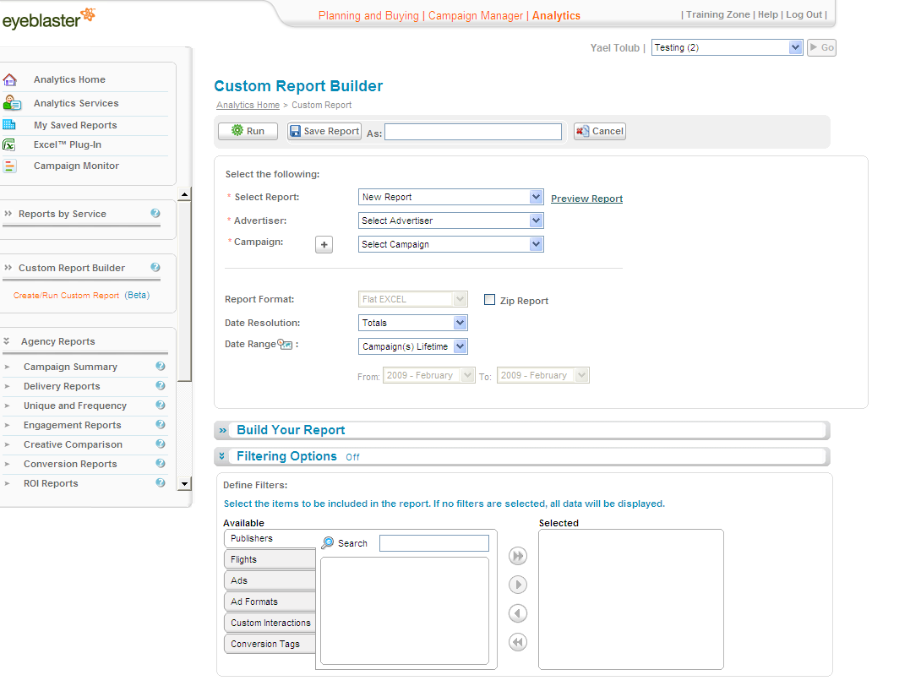
4大技术特性
基于数据模型驱动的敏捷开发模式
自动构建数据管理系统
可管理的数据接口访问控制权限
跨平台、跨技术、跨语言自动生成应用端接入代码

Slide 10




4大项目化特性
开源的独立化部署
自由接入第三方服务
面向开发者的免费云开发模式
开放性的云应用商店
© 2008 Eyeblaster. All rights reserved

Slide 11
五大市场
云开发平台
自动化构建数据管理系统
移动互联网敏捷开发框架
BaaS（Backend-as-a-Service，后端即服务）
知识共享的应用商店

Slide 12

Strength优势
自主研发
著作权、专利、Apache基金会
技术优势
提高效率、减少成本、降低门槛
竞争优势
专注早期、知识付费、免费
创始人
十年草根、优秀企业、技术广、行业广
Notes:
Digital Advertising provides Agencies with something traditional channels have never been able to deliver—The ability to track and measure consumers interactions and engagement with your Brand Message.
However, as Digital advertising has evolved, with multi-channel campaigns, being tracked by disparate reporting systems, the amount and variety of metrics have increased to the point where Agencies are now drowning in a sea of information.
How do you stay afloat in, let alone take advantage of, the overwhelming amount of data that digital campaigns create?
Eyeblaster Analytics

Slide 13

Weakness劣势 && Threat威胁
市场能力
缺少完成团队
缺少证明
经营企业经验
被抄袭的威胁
BaaS不被市场认可
Notes:
Digital Advertising provides Agencies with something traditional channels have never been able to deliver—The ability to track and measure consumers interactions and engagement with your Brand Message.
However, as Digital advertising has evolved, with multi-channel campaigns, being tracked by disparate reporting systems, the amount and variety of metrics have increased to the point where Agencies are now drowning in a sea of information.
How do you stay afloat in, let alone take advantage of, the overwhelming amount of data that digital campaigns create?
Eyeblaster Analytics

Slide 14

Opportunity机会
政策与市场
互联网+下的中国互联网市场
技术趋势
软件开发的必然
需求在改变
企业IT服务化改革、创业者浪潮
BaaS市场不成熟
技术、方向的痛点
Notes:
Digital Advertising provides Agencies with something traditional channels have never been able to deliver—The ability to track and measure consumers interactions and engagement with your Brand Message.
However, as Digital advertising has evolved, with multi-channel campaigns, being tracked by disparate reporting systems, the amount and variety of metrics have increased to the point where Agencies are now drowning in a sea of information.
How do you stay afloat in, let alone take advantage of, the overwhelming amount of data that digital campaigns create?
Eyeblaster Analytics

Slide 15


市场分析——77亿美金
技术趋势
市场趋势
环境趋势

Slide 16
77亿美元背后的市场
据Marketsandmarkets发布的报告，到2017年全球BaaS行业的市场规模也仅为77亿美元。
技术没有捷径
为创业者而生
大趋势下的低风险
数据量大
数据跨度大
企业服务市场
Notes:
Site Overlap. Accurately measure unique users contributed by each publisher. Identify when publishers overlap to deliver multiple impressions to the same user. Site Overlap provides clarity about the effect of each element of your media plan.

Slide 17


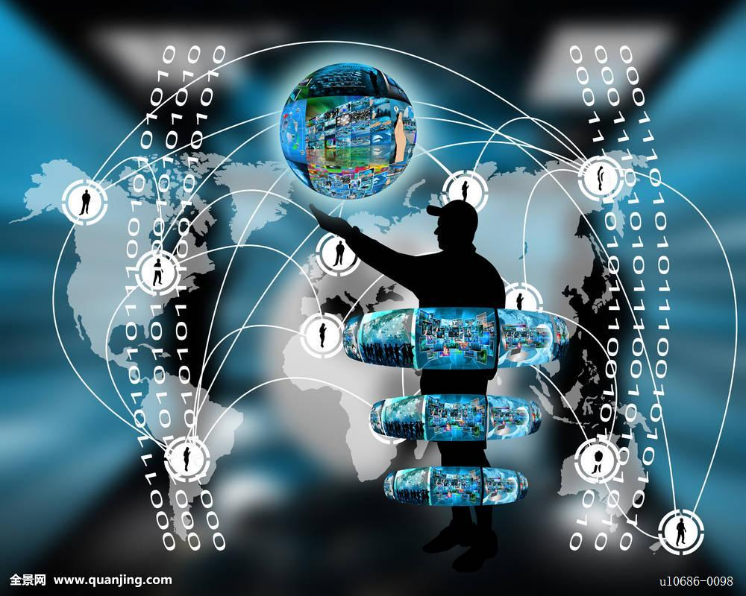
市场分析
技术趋势
技术发展的必然
移动互联网的需要
移动垂直领域的延伸
市场趋势
企业的IT服务潮流
环境趋势
创业创新的浪潮
Notes:
Before the first thumbnail is scribbled on a napkin, you must define the goals of your campaign: What do you want to achieve, how much of it do you want to achieve, and what measurement best communicates the two? Once your goal is defined in terms of collectable data, ask how the creative execution drives towards that goal. And, when the campaign is finished, an in-depth data analysis is crucial to leverage your past experience to better optimise future campaigns. Increase your success metrics by basing your creative plan on sound analytical strategy.

Slide 18
市场趋势——企业的IT服务改革
企业内部信息化之后的对外客户IT服务
实业企业成立软件开发部门是不可能的，对外包是潮流
行业的创新会在移动互联网的基础上出现，颠覆传统行业
实体服务
互联网思想
颠覆传统
Notes:
Site Overlap. Accurately measure unique users contributed by each publisher. Identify when publishers overlap to deliver multiple impressions to the same user. Site Overlap provides clarity about the effect of each element of your media plan.

Slide 19
家装企业IT服务 改革进行时
龙头企业的APP，小公司不想复制吗？ 提供AR/VR的方式跟踪装修进度？
材料供应商商城 完整的售后服务跟踪
实业+IT服务=未来
Notes:
If I usually do something, and as a result I spent twice as long than the average on the page, it’s telling me something - Brand moment is being built.
If they are doing something as a result, it is telling me something. That that brand impact has not caused me to invest more of my time.
So how do we measure time? How do we give it a value? “Dwell Time” is the latest answer from Eyeblaster to try an answer online where TV currently fails – whether the user was in front of the TV or not. It is a solution to justifying the audience is actually taking in the message.
Not just what they did but for “how long” – it is “brand time” – a point of measurement that can show the impact on the audience where they are.
It goes much deeper then reach and frequency. It goes deeper than page open – all they do is show me exposure, not that I have a connected relationship.
The metrics advertisers should look at, for brand campaign, is reach (how many were consumers were affected) frequency (how many times) and dwell time (how long).

Slide 20

市场分析
目标市场
竞争对手
Notes:
Its a busy world and so much is fighting for our attention...
Times have changed. We are in the instant digital world. Its fast-paced learning. Time is now even more precious.
Now in this fragmented world it is about grabbing a few moments of my time.
We have to learn to build brand moments
We need a new way to measure those brand moments, we need to measure time!!
Reveals difference between interest and intent

Slide 21



目标市场
应用开发工程师
数据后端服务
知识共享、消费
爱创业接订单平台
企业级IT服务外包
快速支持企业级的IT服务，为企业提供互联网服务的定制化服务
爱创业平台外包服务
互联网创业项目
协助创业者完成早期项目，组成团队
爱创业平台外包服务
Notes:
Before the first thumbnail is scribbled on a napkin, you must define the goals of your campaign: What do you want to achieve, how much of it do you want to achieve, and what measurement best communicates the two? Once your goal is defined in terms of collectable data, ask how the creative execution drives towards that goal. And, when the campaign is finished, an in-depth data analysis is crucial to leverage your past experience to better optimise future campaigns. Increase your success metrics by basing your creative plan on sound analytical strategy.

Slide 22








竞争对手
Back to Metrics slide
企业级的QingCloud的APPCenter、阿里云移动和AWS的Mobile Hub
致力于构建开发者生态圈的野狗、LeanCloud和Bmob后端云
整合前后端的APPCAN和APICloud
Notes:
Site Overlap. Accurately measure unique users contributed by each publisher. Identify when publishers overlap to deliver multiple impressions to the same user. Site Overlap provides clarity about the effect of each element of your media plan.

Slide 23
企业级的QingCloud的APPCenter、阿里云移动和AWS的Mobile Hub
BaaS只是PaaS业务的一环
主要面向企业级
不是竞争关系
收费贵
QingCloud由蓝驰创投领衔，在2017年6月达成D轮10.8亿人民币的投资
© 2008 Eyeblaster. All rights reserved

Slide 24
致力于构建开发者生态圈的野狗、LeanCloud和Bmob后端云
提供各种移动技术服务，但是因为技术和规模的问题，用户并不想用
使用的技术相同
先后完成千万美元级别的A轮
LeanCloud吸收腾讯TAB成为用户最多
野狗的广告投入较高
Bmob利用支付接入立足
主要竞争对手
© 2008 Eyeblaster. All rights reserved

Slide 25
整合前后端的APPCAN和APICloud
前端开发技术基础
前端开发用户的用户基础
技术上并未被任何，市场份额正在下滑
© 2008 Eyeblaster. All rights reserved

Slide 26
比较分析
BaaS | 数据存储方式 | 后台管理系统 | 社交应用集成 | 消息推送 | 文件存储 | 通信 | 分析 | 安全校验 | 接口集成方式 | 接口语言支持 | 价格
阿里云移动 | 多种存储方式 | 无 | 无 | 有 | 有 | 无 | 有 | 有 | API Gateway | Lambda | 较贵
LeanCloud | NoSql的列存储 | 无 | 无 | 有 | 有 | 无 | 有 | 无 | Restful | JS | 便宜
野狗 | NoSql的列存储 | 无 | 无 | 有 | 有 | 有 | 有 | 无 | Restful | 无 | 便宜
Bmob后端云 | NoSql的列存储 | 无 | 第三方支付 | 有 | 有 | 无 | 有 | 无 | Restful | JS | 便宜
APPCan | NoSql的列存储 | 无 | 第三方登录、支付 | 有 | 有 | 有 | 无 | 无 | Restful | 无 | 中
AppLink | Mysql，SQLServer，Oracle | 自动生成 | 通过插件集成 | 通过插件集成 | OSS存储或服务器本地 | 通过插件集成 | 无 | 通过插件集成 | Restful | PHP | 免费
© 2008 Eyeblaster. All rights reserved

Slide 27
竞争策略
完全免费的开发平台，商业授权的技术使用
低廉高效的企业IT服务和创业的外包开发服务
© 2008 Eyeblaster. All rights reserved

Slide 28




商业模式-商业授权
盈利模式1
互联网产品
甲方给钱、乙方付款
技术绑定、吸血成长
交付
商业授权收费
技术
人力
时间
技术/云服务
需求
金钱
甲方
创始人
乙方
程序员
免费使用
减少产品开发过程中的
技术、人力、时间
APP后端云

Slide 29
如何盈利
盈利模式2
面向软件开发者免费的服务，对商业应用进行授权付费。
目前暂定一个应用上线需要收取4000元/年或30000元永久的授权模式。
软件的成功是我们长期盈利的基础！
商业授权
1
有偿服务
2
除了正常的平台服务，我们将会购买或开发其它有偿服务供开发者选购。
模式复制
3
将APP后端云以平台授权的方式服务软件开发企业，让APP后端云强大的开发模式复制到其它企业。
我们自己就将会是第一家企业！

Slide 30
目标
我们的目标是什么？
我们的特点是大幅度提高生产效益，那么创造产值才是我们的首要目的，17年目标是让100万开发合同在APP后端云完成。
创造产值
基于APP后端云强大的开发支持，我们自己要来做软件外包，我们有信心用最低的价格，最快速的生产速度和最优质的服务来成为外包龙头！
击败外包龙头
软件开发生态圈
未来，我们不仅仅是为开发者服务，我们18年的产品将是一个面向整个开发生态圈的产品。创客在这里出想法，产品经理做需求，产品设计师做设计，测试人员保证质量，运维工程师帮上线！让项目开发的所有人都能人都能把知识用起来，创造价值！
除了帮开发端的人获益之外，我们也同样要为创客们服务！
早期孵化服务
众筹
引入天使投资
帮助用户成功

Slide 31
生态圈的商业模式
独一无二的APP后端云将会这么设计
互联网产品
测试经验
天使
运维上线
测试员
开发技术
孵化
AppLink
需求
金钱
设计
甲方
创始人
产品经理
开发人员

Slide 32
项目现况
时间表
团队配置
投资需要
Notes:
Its a busy world and so much is fighting for our attention...
Times have changed. We are in the instant digital world. Its fast-paced learning. Time is now even more precious.
Now in this fragmented world it is about grabbing a few moments of my time.
We have to learn to build brand moments
We need a new way to measure those brand moments, we need to measure time!!
Reveals difference between interest and intent

Slide 33
时间表
2016年12月AppLink项目正式启动。
2017年1月中旬，AppLink项目1.0版本正式完成，约三万行代码。
2017年3月中旬，AppLink项目完成其他部分，正式推向市场。
2017年6月，基于AppLink的核心技术的研发技术，完成爱创业平台。
2017年8月为止，AppLink项目已经先后完成创桥教育科技的“成功父母必听”，“大脑检测系统”，“空中幼儿园”三个项目、“BB操手”金融指标分析APP、“宠物流浪日记”等项目。
2017年9月，创桥教育科技已完成600万元人民币的天使阶段融资，并与AppLink平台签署战略合作伙伴关系协议。
© 2008 Eyeblaster. All rights reserved

Slide 34
人员配置
创始人——蔡笋
深圳大学软件工程硕士
PMP
全栈工程师
Dev-Ops
ipiao.com首席开发
金蝶k3Cloud供应链系统架构师Morningstar的AWS部门Dev-Ops和架构师
十年移动互联网外包经营
联合创始人—胡春生
市场战略顾问
深运工贸企业有限公司市场部及人事部经理
协助深运集团进军餐饮业的市场
联合创始人—张少龙
市场及投资顾问
澳洲麦考瑞大学本科、硕士海归
华为巴基斯坦项目的安全事务官
澳洲智维投资集团开展商业中心的投资事务
Notes:
Before the first thumbnail is scribbled on a napkin, you must define the goals of your campaign: What do you want to achieve, how much of it do you want to achieve, and what measurement best communicates the two? Once your goal is defined in terms of collectable data, ask how the creative execution drives towards that goal. And, when the campaign is finished, an in-depth data analysis is crucial to leverage your past experience to better optimise future campaigns. Increase your success metrics by basing your creative plan on sound analytical strategy.

Slide 35
种子期的需求——10%换取100万人民币
组建5人平台研发团队
组建5人市场开发团队
组建5人项目外包团队
租赁办公场所及用品等
租赁服务器等
申请各种证明、创新等费用
© 2008 Eyeblaster. All rights reserved

Slide 36


Thank you
蔡笋
联系我
联系电话：13751082562
微信/QQ： 359304951
邮箱：alucard263096@126.com
访问APP后端云

